Slide 1

Megaminx
MMR 2020 – Group 3

Slide 2
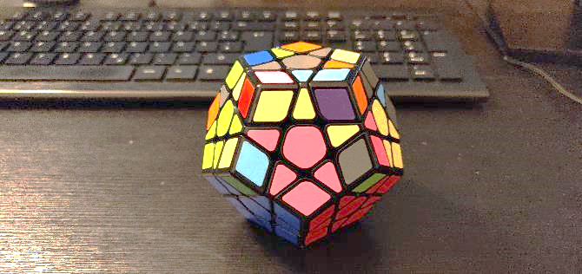
Goals
Reminder: Goal 79

Slide 3
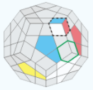
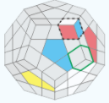
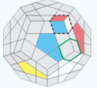
ALGORITHMS
SP5
SP6
SP7
U R U‘ R‘
R U R‘
(R U‘ R‘) U U R U R‘

Slide 4
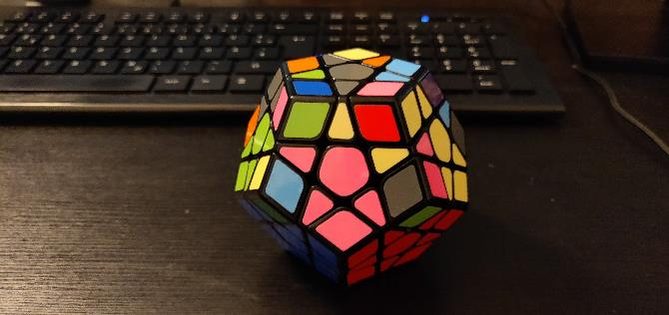
Goals
Goal 80
Moves: all

Slide 6
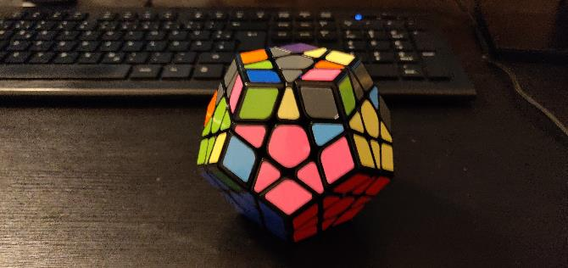
Goals
Goal 81
Moves: sp5, sp6, sp7

Slide 7
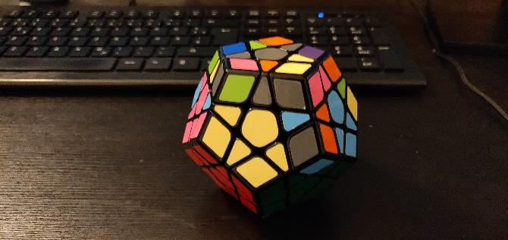
Goals
Goal 82
Moves: r_v

Slide 9
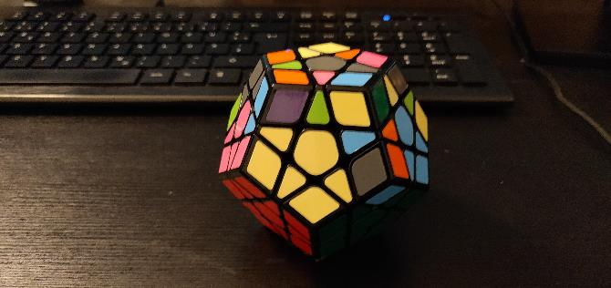
Goals
Goal 83
Moves: all

Slide 10
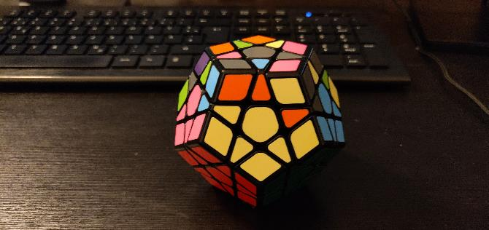
Goals
Goal 84
Moves: sp5, sp6, sp7

Slide 11
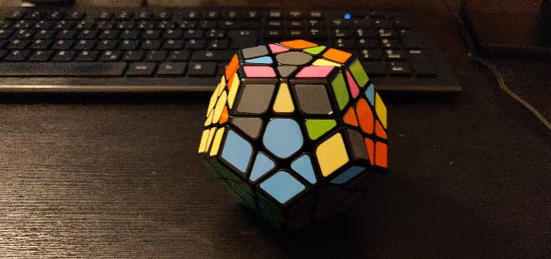
Goals
Goal 85
Moves: r_v

Slide 13
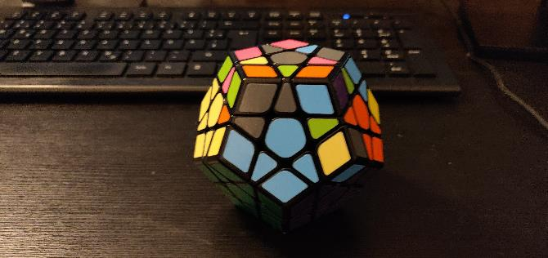
Goals
Goal 86
Moves: all

Slide 14
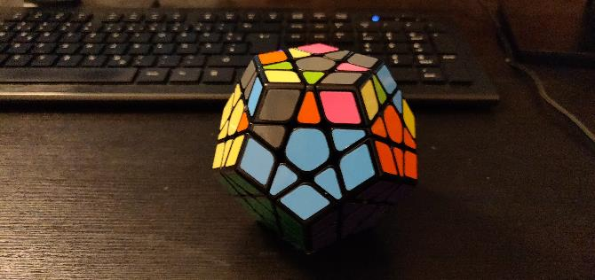
Goals
Goal 87
Moves: sp5, sp6, sp7

Slide 15
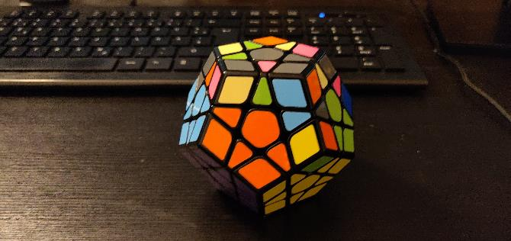
Goals
Goal 88
Moves: r_v

Slide 17
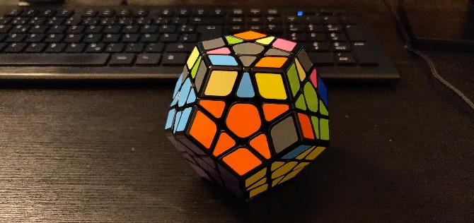
Goals
Goal 89
Moves: all

Slide 18
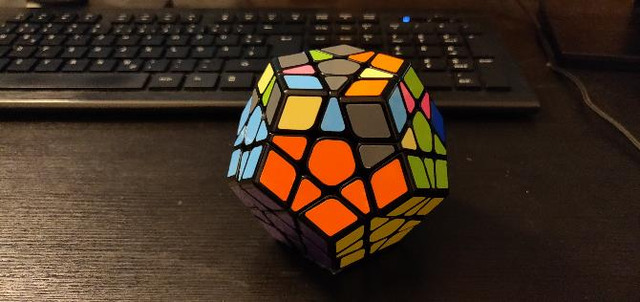
Goals
Goal 90
Moves: sp5, sp6, sp7

Slide 19
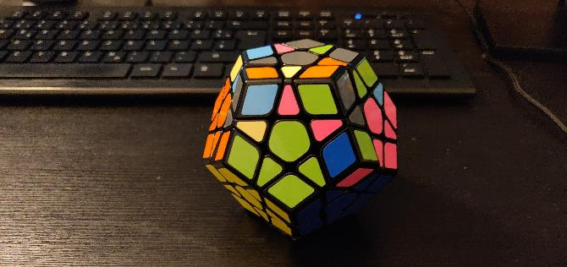
Goals
Goal 91
Moves: r_v

Slide 21
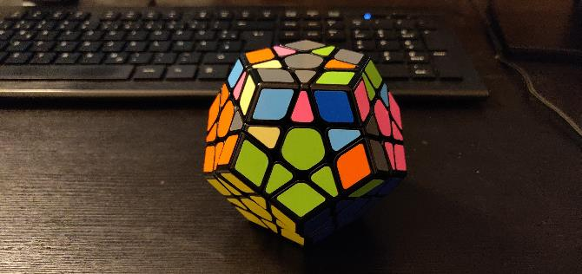
Goals
Goal 92
Moves: all

Slide 22
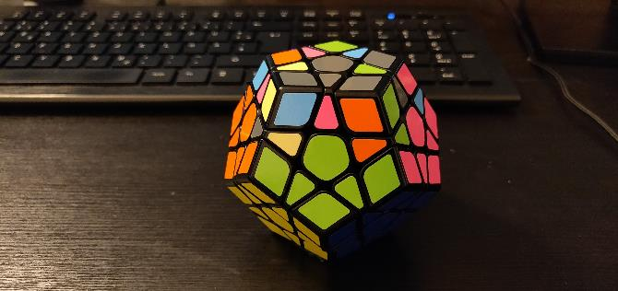
Goals
Goal 93
Moves: sp5, sp6, sp7

Slide 23
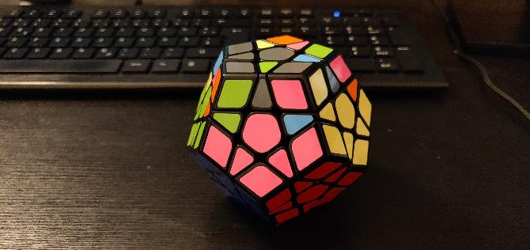
Goals
Goal 94
Moves: r_v

